Slide 1


Probabilistic forecasting I: Temperature
A Short Presentation
Carl McBride Ellis. (2024). Probabilistic forecasting I: Temperature. Kaggle. https://kaggle.com/competitions/probabilistic-forecasting-i-temperature
S. Degeye / 2024-09-19 / Third Cohort on Conformal Prediction (Valeriy Manokhin)

Slide 2
Contents
Goal of the competition
Strategy
Kaggle Dataset Setup
Features/Target values
EDA (Exploratory Data Analysis)
Features Engineering
CQR (Conformalized Quantiles Prediction) Process
ICP (Inductive Conformal Prediction) Dataset Setup
Model Fitting on Proper Training Set (Catboost, Hyperparameters tuning, Pinball loss function,…)
Prediction on Calibration Set
Non-Conformity Score computation
Quantile Computation (Correction factor to be applied on Points Prediction)
Prediction Intervals Computation
Evaluation Metrics
Submission File
The secret of victory
Notes:
As you know, Conformal Prediction framework is on top on any model (in our case catboost)

Slide 3

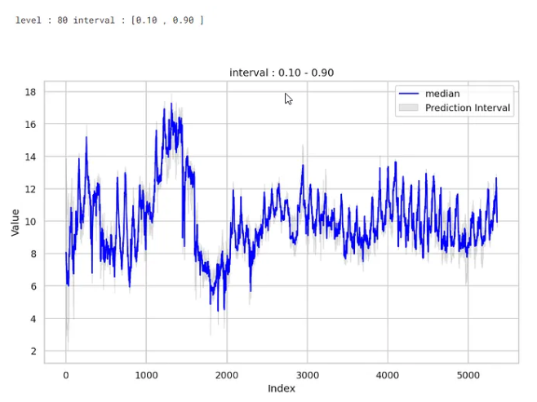
Goal of the Competition
95: ['0.025', '0.975'], 90: ['0.05’, '0.95'], 80: ['0.10’, '0.90'], 70: ['0.15’, '0.85'], 60: ['0.20’, '0.80'], 50: ['0.25’, '0.75'], 40: ['0.30’, '0.70'], 30: ['0.35’, '0.65'], 20: ['0.40’, '0.60'], 10: ['0.45’, '0.55']

Slide 4
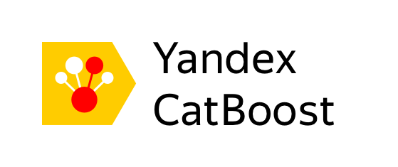
Strategy
I decided to take advantage of the competition to apply the 'Conformal Prediction' framework, as it is necessary to calibrate the results to be consistent with the past experience.
My choice was to treat this competition as a regression problem (not the application of classical Autoregressive models such as SARIMAX) and my choice was Catboost from Yandex
Emmanuel Candes, Evan Patterson and Yaniv Romano have created a framework called Conformalized Quantiles Regression (CQR) and that’s the solution I’ve chosen to tackle the competition.
This is an obvious choice for generating adjusted prediction intervals (PI) by readjusting each quantile and therefore considering of Heteroskedasticity (Asymmetric Prediction Interval)
Catboost MultiQuantiles regressor as base model
Conformalized Quantiles Regression (CQR) Framework for Uncertainty Quantification (UQ)

Slide 5
Competition Dataset Setup
01/07/2016
ID = 0
01/05/2018
ID = 64319
02/05/2018
ID = 64320
29/05/2018
ID = 67007
~ 28 Days to be forecasted
Competition
Start
Training Set
Public Test Set
Private Test Set
30/05/2018
ID = 67008
26/06/2018
ID = 69679
01/07/2016
ID = 0
~ 28 Days to be forecasted
01/07
Training Set + revealed 28 days of Public Test Set
Public Test Set
Private Test Set
End of
Competition
Half of the Public Test Set revealed for the last month of the competition!

Slide 6
EDA (Exploratory Data Analysis)
EDA is one of the most important steps, along with features engineering and model selection. Data visualization and pattern discovery is an indispensable step.
Data Overview
Time Series Overview
Features/Target Distribution
Missing Data
Partial Autocorrelation Function Plot
Check for Stationarity
Of course, there is room for improvement!

Slide 7
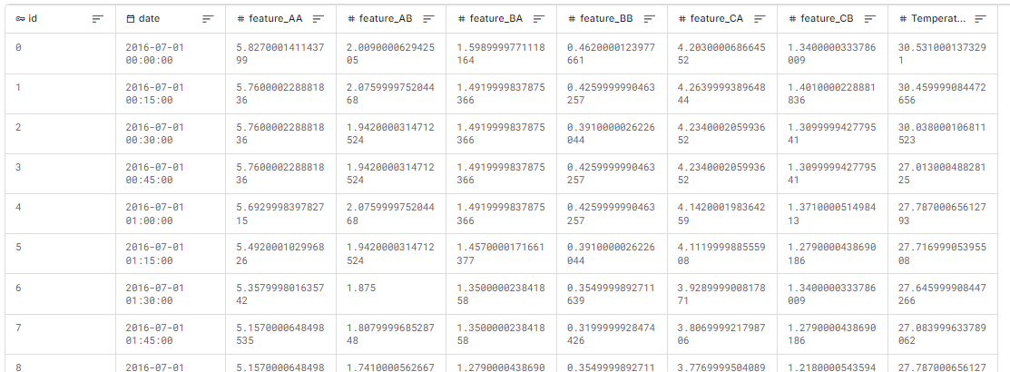
Data Overview
Numerical Feature
Time Progression
Numerical Features
(co-variates/exogenous)
Anonymization: We do not know the meaning behind these features.
Target Value
(Response variable)
Useful for building
Calendar features
Features Engineering will be discussed later in this presentation

Slide 8
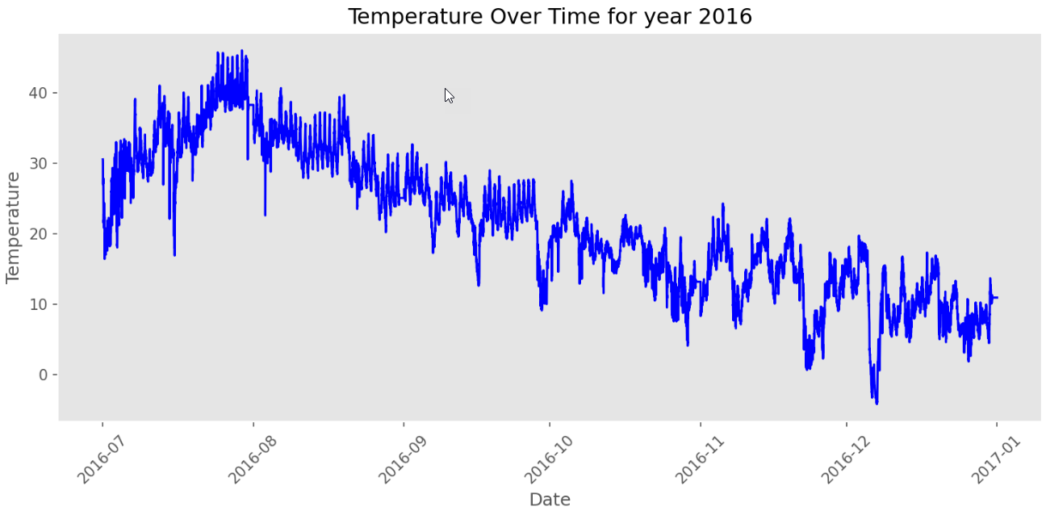
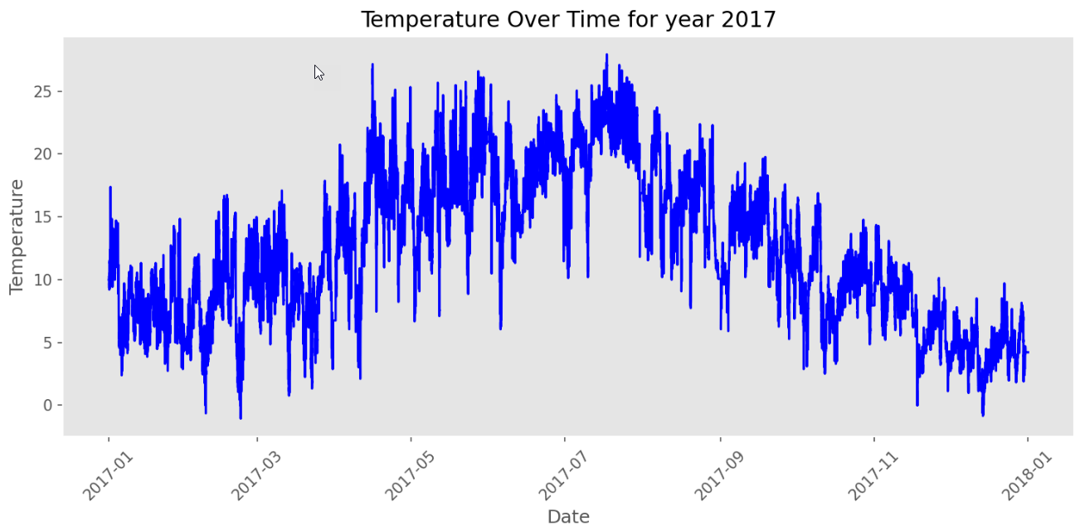
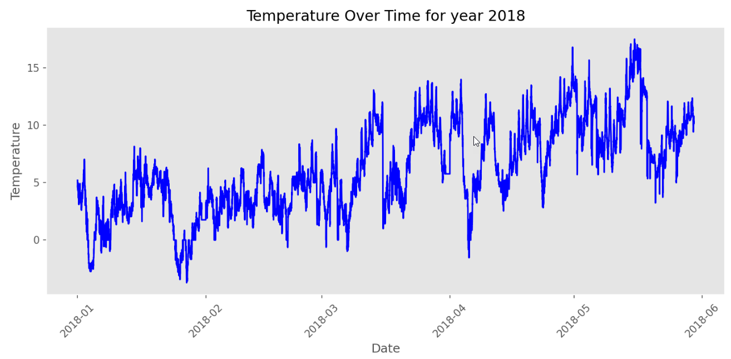
EDA : Time Series Overview
I've added the separate graphs to emphasize that it's always interesting to look at a larger period.
One thinks directly of an upward and downward trend, but that's just part of the variation in seasonality

Slide 9
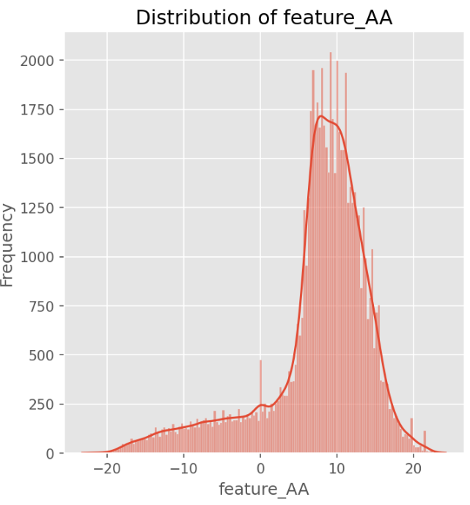
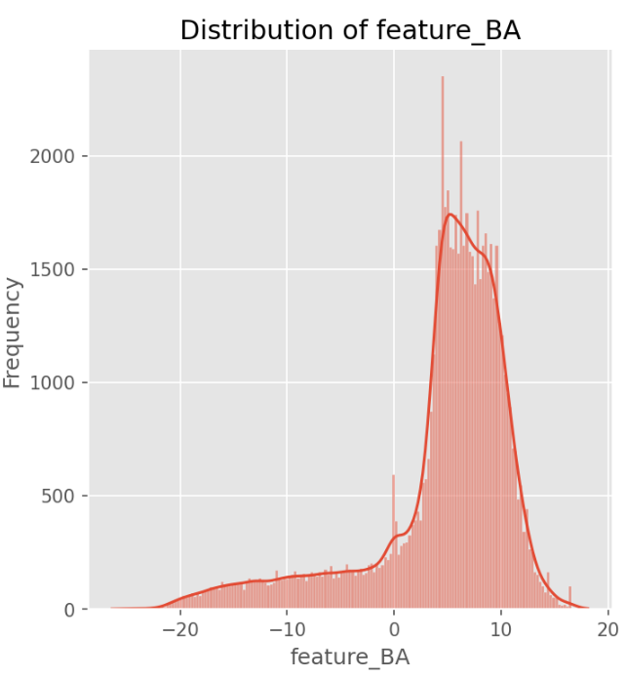
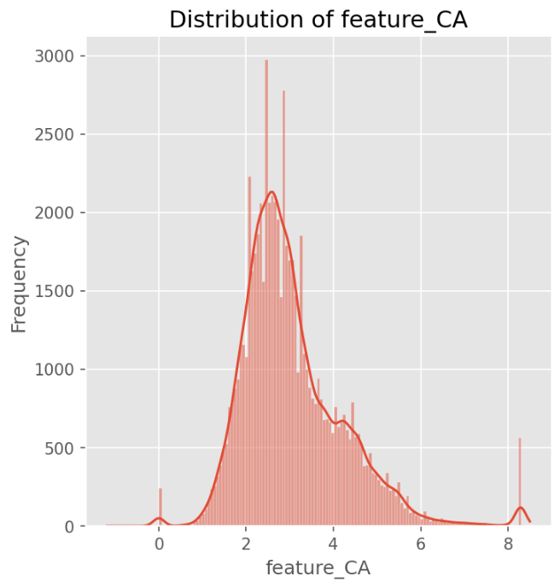
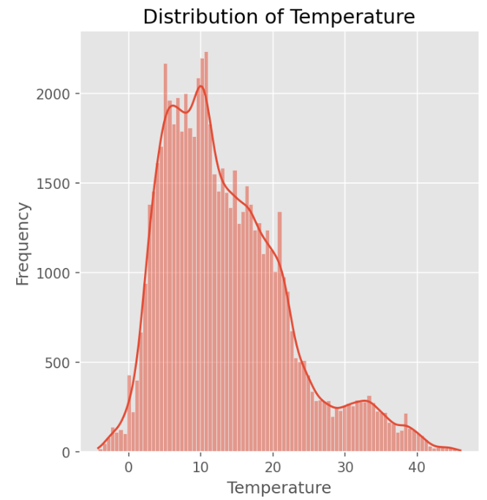
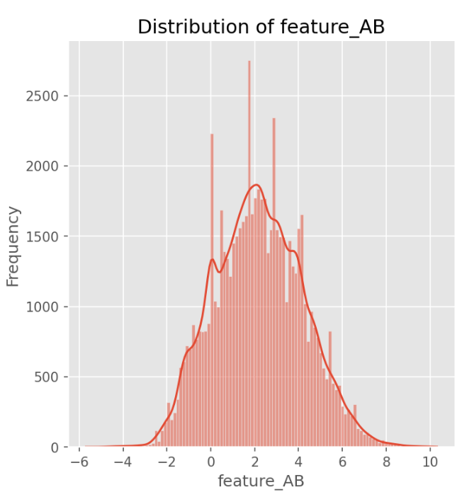
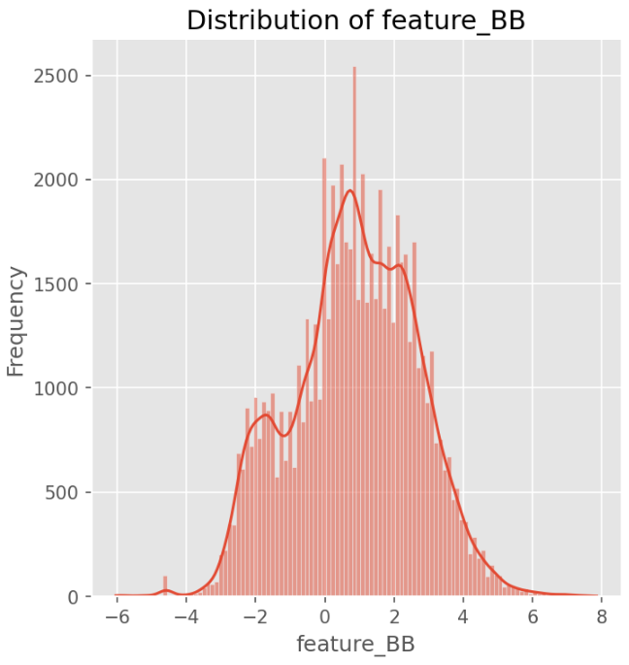
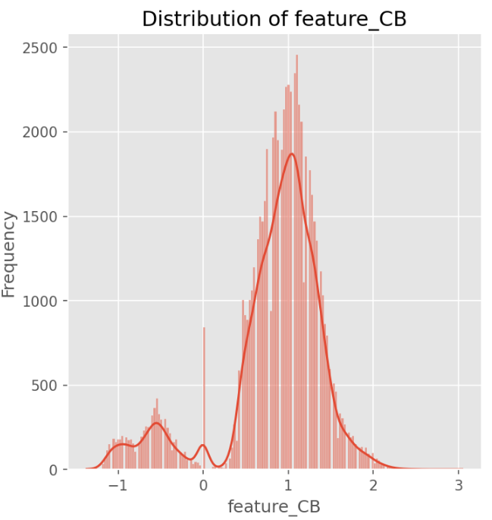
EDA : Data Distribution
The visualization of distributions could, for example, determine how to impute missing data
(Mean or Median Imputation)
Distribution is something that needs to be monitored in operational systems to detect data drift (MLOps)

Slide 10
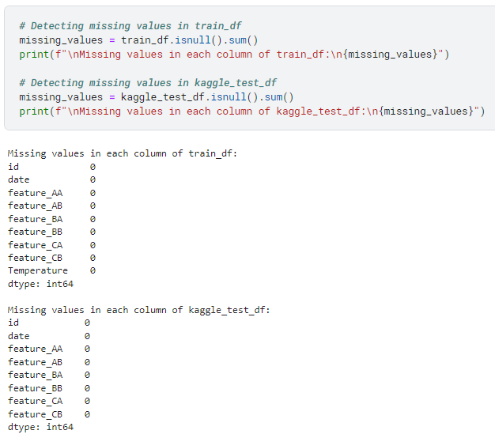
EDA : Missing Data
The first thing we can check are the uninitialized values in the existing records
For the sake of completeness, we should also check :
Records could also be non-existent (gaps in the data)
Zone(s) with no variation in the data
Unusual Values (Outliers, negative values,….)
In some cases, it will probably be useful to make an imputation such as :
Mean / Median Imputation (may depend on the underlying distribution)
Last Observation Carried Forward (LOCF) => Forward Fill Propagation
Next Observation Carried Backward (NOCB) => Backward Fill Propagation
All this, of course, needs to be assessed with knowledge of the underlying subject, and the various stakeholders can be helpful at this stage.

Slide 11
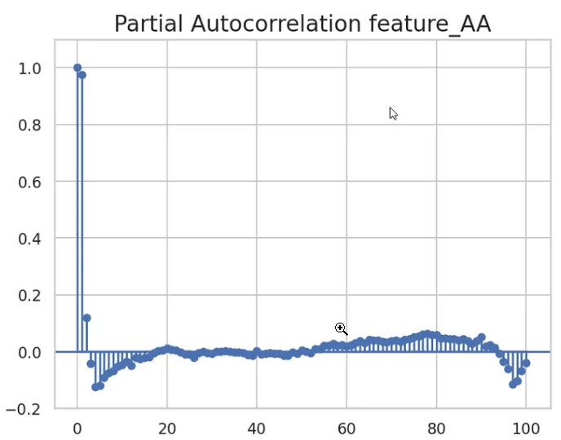
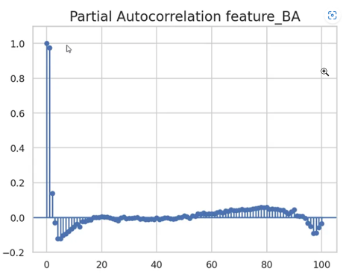
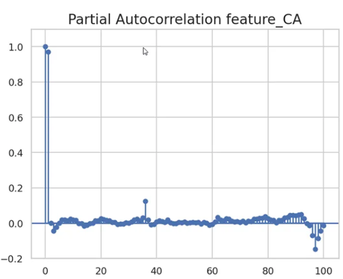
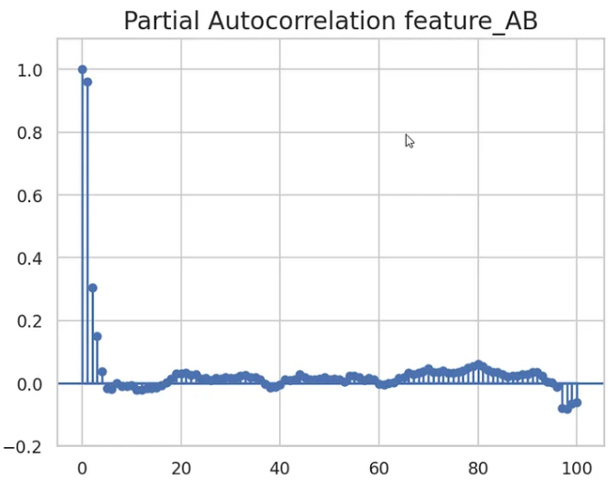
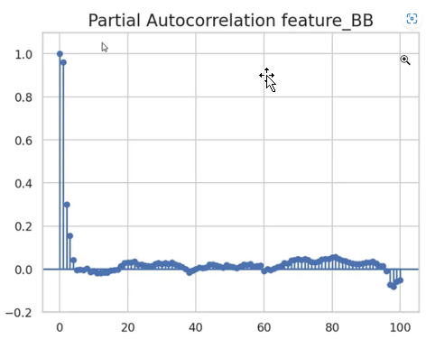
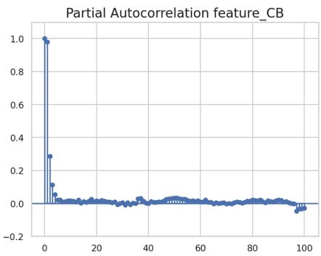
EDA : Partial AutoCorrelation Function Plot
PACF : direct correlation between a time series and its lagged values
(by removing the influence of intermediate lags)
This makes PACF useful for determining the number of autoregressive terms needed in a model

Slide 12
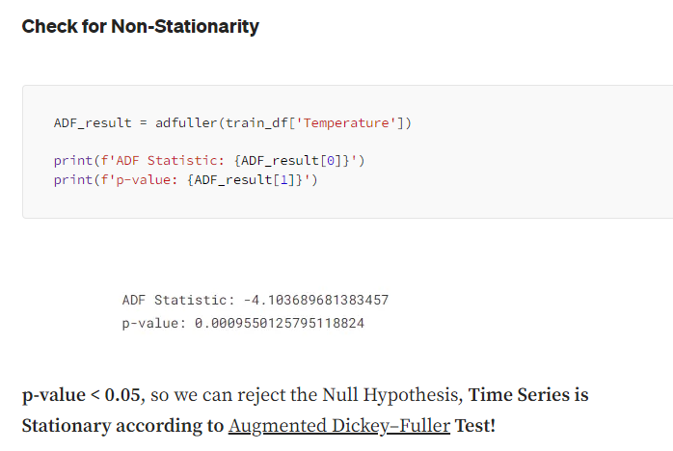
EDA : Check for Stationarity
It's a good habit to always check whether a time series is stationary or not.
It's a prerequisite for Autoregressive models (one or more differencing will be necessary if not stationary)
My feeling is that this is not a hard requirement for Catboost regressor (I'd like to explore this in more details)
In our case, the ADF Test result indicates that our time series is stationary

Slide 13
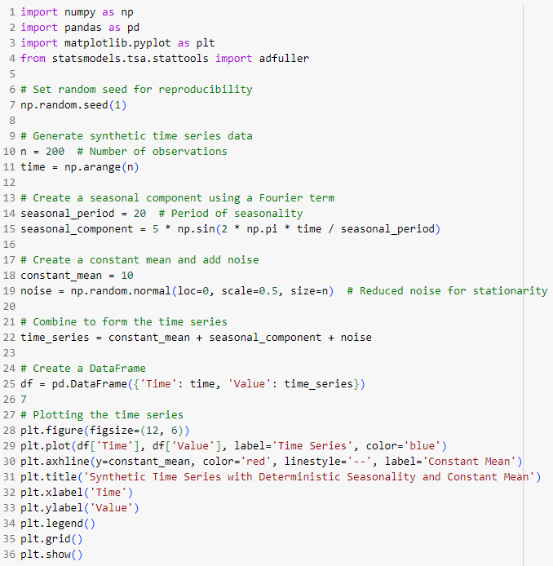
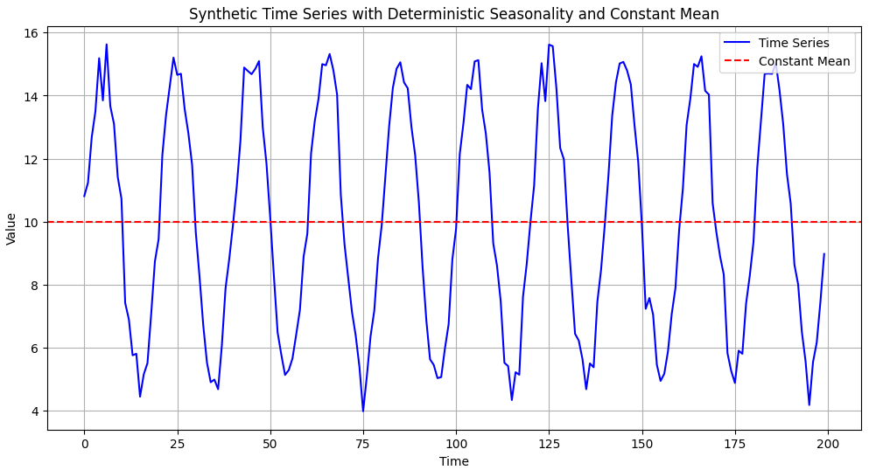
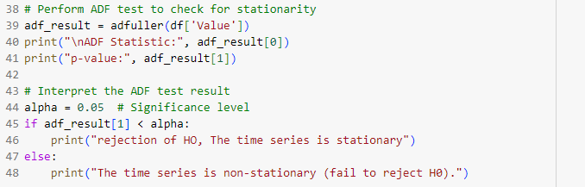

EDA : Stationarity with seasonality
A stationary time series can display a seasonality

Slide 14
Feature Engineering
We have already seen that the chosen strategy is to treat the problem as a regression problem.
We are therefore no longer dealing with the ‘difference equation’ of an autoregressive model.
For our regression problem, we need to embed the temporal information as features of our model
There is no time travel between row_{t} , row_{t-1} , row_{t-2} , row_{t-x} in a regression model
(all necessary information must be packed with each record)
Of course, during the Feature Engineering stage, and particularly for lag feature, the order of records in the dataset is important.
Calendar Features / Temporal progression
Lag Features
Fourier Terms
Remove High Correlated Features

Slide 15
Features : Calendar Features / Time Progression
Periodic patterns are modelized based on calendar units (day, day of week, month, …)
# Create Calendar Features train_df['year'] = train_df['date'].dt.year.astype(int) train_df['month'] = train_df['date'].dt.month.astype(int) train_df['day'] = train_df['date'].dt.day.astype(int) train_df['hour'] = train_df['date'].dt.hour.astype(int) train_df['week_of_year'] = train_df['date'].apply(lambda x: x.isocalendar()[1]) train_df['day_of_week'] = train_df['date'].dt.dayofweek.astype(int)
# inform model about the temporal progression of the data train_df['id'] = train_df['id'].astype(float) kaggle_test_df['id'] = kaggle_test_df['id'].astype(float)
In my baseline, my first idea was to treat Calendar features as numerical and not as categories
(to give an idea of time progression and similar moment in time)
Another possibility is to treat Calendar Features or a subset of them as categories.
In this case, target statistics would be imputed to each category (Target Encoding)
There's still a lot to be explored on this subject, and there is just one good solution

Slide 16
Features : Lag values
That’s a way to inform your regression model with the Autoregressive Aspect of the time series
Interesting if the number of lag features is limited
Easily interpretable, based on EDA results (PACF Plots)
# Create Lag Features features_prefix = "feature_" features_suffix = "_lag_" lag_features = [ {'AA' : ['1', '2', '4', '6', '97', '98']}, {'AB' : ['1', '2', '3', '98']}, {'CA' : ['1', '36', '97', '98']}, {'CB' : ['1', '2', '3']} ] for lag_feature in lag_features: for lag_list in lag_feature.values(): for lag in lag_list: train_df[features_prefix + ', '.join(lag_feature.keys()) + features_suffix + lag] = train_df[features_prefix + ', '.join(lag_feature.keys())].shift(int(lag)) kaggle_test_df[features_prefix + ', '.join(lag_feature.keys()) + features_suffix + lag] = kaggle_test_df[features_prefix + ', '.join(lag_feature.keys())].shift(int(lag))

Slide 17
Features : Fourier Terms
Periodic signal can be breakdown in several sin/cosine functions of different frequencies.
Initial signal can be rebuilt by adding all its component
Switch from Time Domain to Frequency Domain
Useful to model long seasonal periods (avoiding multiples lag features)
# Create Fourier terms for daily seasonality train_fourier_day = np.sin(2 * np.pi * np.arange(len(train_df)) / 96) train_fourier_day += np.cos(2 * np.pi * np.arange(len(train_df)) / 96) train_df['fourier_terms_day'] = train_fourier_day kaggle_test_fourier_day = np.sin(2 * np.pi * np.arange(len(kaggle_test_df)) / 96) kaggle_test_fourier_day += np.cos(2 * np.pi * np.arange(len(kaggle_test_df)) / 96) kaggle_test_df['fourier_terms_day'] = kaggle_test_fourier_day # Create Fourier terms for weekly seasonality train_fourier_week = np.sin(2 * np.pi * np.arange(len(train_df)) / 96*7) train_fourier_week += np.cos(2 * np.pi * np.arange(len(train_df)) / 96*7) train_df['fourier_terms_week'] = train_fourier_week
kaggle_test_fourier_week = np.sin(2 * np.pi * np.arange(len(kaggle_test_df)) / 96*7) kaggle_test_fourier_week += np.cos(2 * np.pi * np.arange(len(kaggle_test_df)) / 96*7) kaggle_test_df['fourier_terms_week'] = kaggle_test_fourier_week
My work for this baseline was more experimental but my initial idea was to add Fourier terms for more longer periods such as one year period

Slide 18
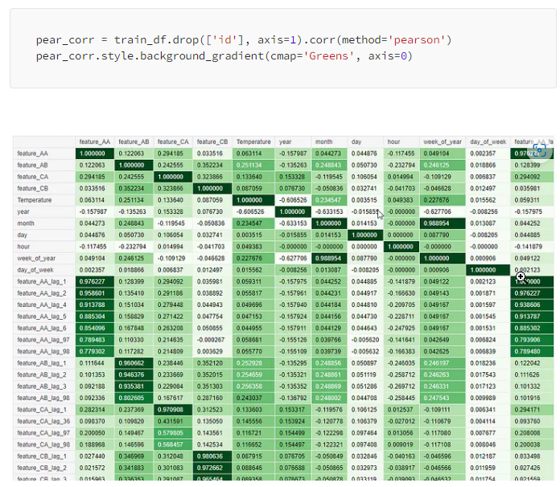
Features : Pearson Pairwise Correlation Matrix
1 indicates a perfect positive linear relationship
-1 indicates a perfect negative linear relationship
0 indicates no linear relationship

Slide 19
Features : Remove highly correlated features
It's always worth reducing complexity for the model
# Remove highly correlated features (unnecessarily increase model complexity) train_df.drop('feature_BA', axis=1, inplace=True) train_df.drop('feature_BB', axis=1, inplace=True) train_df.drop('date', axis=1, inplace=True) kaggle_test_df.drop('feature_BA', axis=1, inplace=True) kaggle_test_df.drop('feature_BB', axis=1, inplace=True) kaggle_test_df.drop('date', axis=1, inplace=True)
Two features are highly correlated
There is no added value in keeping them all
You have to be careful in the real world, because what's true at a given moment may not be true in the future (monitoring is needed).

Slide 20
CQR Process
Dataset Setup to fit the ICP Framework
Multiquantiles Regressor Model Training on Proper Training Set
Prediction on Calibration Set
Non-Conformity Scores Calculations (Output = Error distributions)
Compute Quantile based on User Confidence Level applied on Error distributions
Adjust the predicted quantiles based on the previous CQR computed quantile

Slide 21
ICP Dataset Setup
The first step is to keep a calibration set separate from the proper training set.
Training Set
Public Test Set
X_train, X_val, y_train, y_val = train_test_split(X, y, test_size=5360)
Training Set
Validation Set
Public Test Set
X_proper_train, X_cal, y_proper_train, y_cal = train_test_split(X_train, y_train, test_size=0.12, random_state=1)
Proper Training Set
Calibration Set
Validation Set
Public Test Set
The Calibration set will play a role in determining the Non-Conformity scores.
ICP* : Inductive Conformal Prediction

Slide 22
Model Fitting on Proper Training Set
The second step is the classic basic training.
Goal : Train a model (for predicting the separate Calibration & Public Test Set in the next steps)
Proper Training Set
# model definition multiquantiles_model = CatBoostRegressor( loss_function = f'MultiQuantile:alpha={quantile_str}', thread_count = -1, bootstrap_type = ‘Bernoulli’, sampling_frequency= 'PerTree', iterations = 10000, **{ 'learning_rate': 0.015, 'max_depth': 10, 'subsample': 0.75, 'colsample_bylevel': 0.9, 'min_data_in_leaf': 45 }, verbose=1000 ) # model fitting on training set multiquantiles_model.fit(X_proper_train, y_proper_train, eval_set=(X_val, y_val))
MultiQuantiles
Regressor
Model
Model Output
In the following slides, I will provide some additional information on the model

Slide 23

Simplified Vision of Gradient Boosting
Iterative combination of weaker models (ensemble) to form a strong model
Sequence of model that learn error (residual error) done by the previous one
Y_pred_tot
y_pred_M2
y_pred_M2
y_pred_M3
Model 1
Model 2
Model 3
Training data
Target is
y_true
Training data
Target is
y_true - y_pred_M2
Training data
Target is
y_true - y_pred_M1 - y_pred_M2

Slide 24
Why CatBoost?
CatBoost (Categorical Boosting) Addresses two main Target Leakage Issues :
The first is inherent to gradient boosting Algorithms
The second during the conversion of categorical features into number (Target encoding)
Catboost solves two problems by introducing a unique technique called 'Ordered Target'.
(By using random permutations of the dataset to build each trees and to build Target Statistics)
Source Catboost : gradient boosting with categorical features support

Slide 25
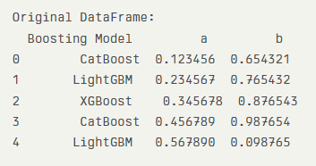
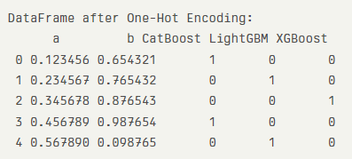
Categorical Features : one-hot-encoding
Binary feature is assigned for each category with a ‘One’ for the selected Category and zero for all others
Classical Boosting models perform One-Hot encoding during the preprocessing phase
(only Acceptable for Low-Cardinality Features)
Contrary to other Model Catboost processes one-hot-encoding during the training phase
(one-hot-max-size) parameter exists to specify a limit in which Catboost will apply or not one-hot-encoding in case of higher value, target statistics will be used)
One-Hot encoding

Slide 26

Categorical Features : Target Statistics
A better way to deal with Categorical Features is to applied what is called a Target Statistics
Target Statistics is implemented in a smart way in Catboost to address two issues :
Issue relating to the implication of the target of a row in the calculation of a value for this same row
Issue related to Low-Cardinality Categorical Features
(E.g only a single example of a category exists, Target Statistics will be the target value of this example)
Catboost solution :
Catboost perform permutations and compute average label value for the example with the same category value placed before the given one in the permutation (from j=1 to p-1)
Catboost Apply a Laplace Smoothing (add a prior value P and a parameter α > 0 being the weight of the prior. it helps to reduce the noise obtained from low-frequency Categorical Features
(standard technique for calculating prior is to take the average label value in the dataset)
Source : Catboost

Slide 27
Catboost : Hyperparameters
Here are the hyperparameters used in the competition:
Hyperparameters | Description | Value
thread_count | The number of threads to use during the training. | -1
bootstrap_type | split method for a tree when building the tree structure | ‘Bernoulli’
sampling_frequency | Frequency to sample weights and objects when building trees | ‘PerTree’
iterations | The maximum number of trees that can be built | 10000
learning_rate | Learning rate used for reducing the gradient step | 0.015
max_depth | Depth of the trees | 10
subsample | Sample rate for bagging | 0,75
colsample_bylevel | The percentage of features to use at each split selection | 0,9
min_data_in_leaf | The minimum number of training samples in a leaf | 45
There's no single rule for knowing which parameters to use.
There's also room for improvement here, using regularization parameters, Early stopping, gpu, ...
Source Catboost : Overview | CatBoost

Slide 28
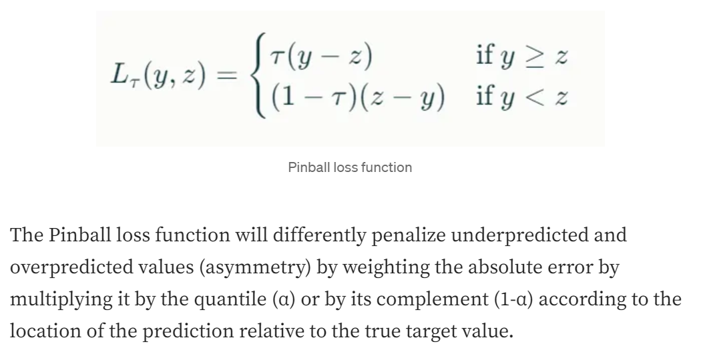
Pinball Loss Function
If the prediction is below the actual value (underprediction), the loss is weighted by τ
If the prediction is above the actual value (overprediction), the loss is weighted by 1−τ
This loss function for predicting conditional Quantiles replaces the usual :
L2 Loss a.k.a Mean Squared Error (MSE) for predicting the conditional Mean
L1 Loss a.k.a Mean Absolute Error (MAE) more robust to outliers for predicting conditional Median
MAE is a special case of Pinball Loss where the quantile is the median

Slide 29
Pinball Loss Function
Let's consider a product whose actual sales for a given period :
Actual Sales = 100 units
Target Quantile Level (τ) = 0.1
Let’s consider two different predictions :
Underprediction :
Predicted Sales (Y_{pred}​) = 90 units
Pinball Loss = 0.1 × (100 - 90) = 1
The larger the quantile, the greater the penalty
Overprediction :
Predicted Sales (Y_{pred}​) = 110 units
Pinball Loss = (1 - 0.1) × (110 − 100) = 9
The smaller the quantile, the greater the penalty

Slide 30
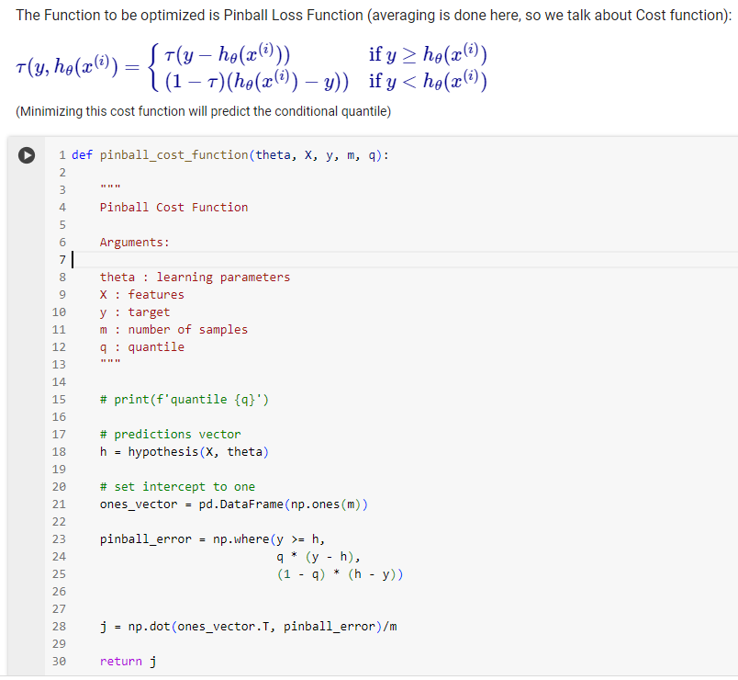
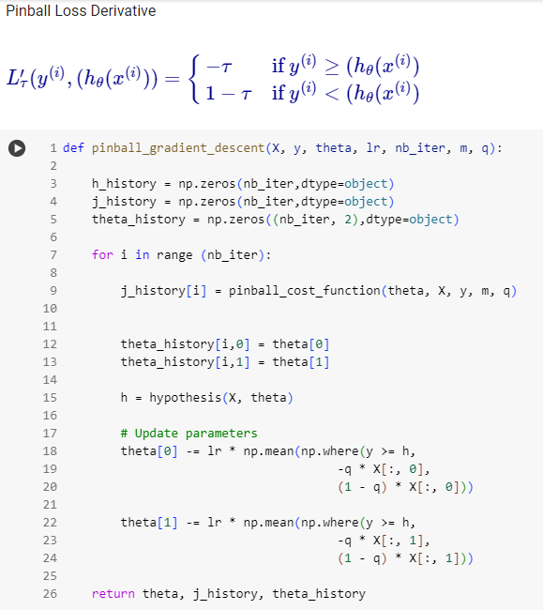
Pinball Loss Function
I'll soon be sharing with you a story on Medium with the full code from scratch dedicated to Quantile Regression and the Pinball Loss Function (some extracts are shown above)

Slide 31



Prediction on Calibration Set
Proper Training
Set
The third step consists in using the training results to make the prediction on the Calibration Set and thus obtain the Quantiles Points Prediction
In the case of Multiquantiles Regression, the prediction is not a single value but a set of quantiles (which are passed as arguments to the model)
MultiQuantiles
Regressor
Model
Prediction of all quantile's pairs
Model Output
Q_{pred}
Calibration Set
Nonconformity Scores
(Residuals Errors)
Non-Conformity
Measure
Y_{Cal}
Ground Truth Target

Slide 32

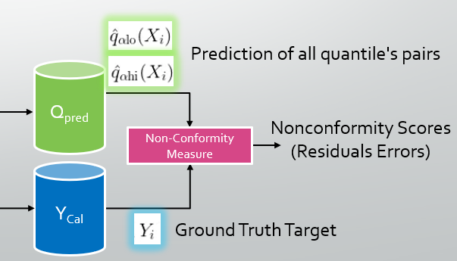
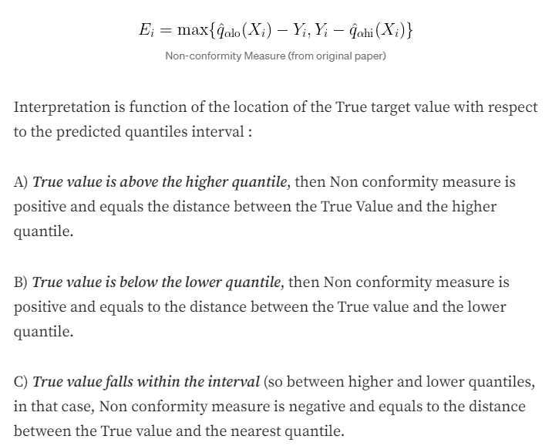
Non-conformity Scores Computation
How predicted Quantiles relate to the True value ?
We need a Non-Conformity Measure !
Non-Conformity Measure (Y_{True}, Q_{Pred}) = Non-Conformity Scores
A)
B)
C)
C)

Slide 33

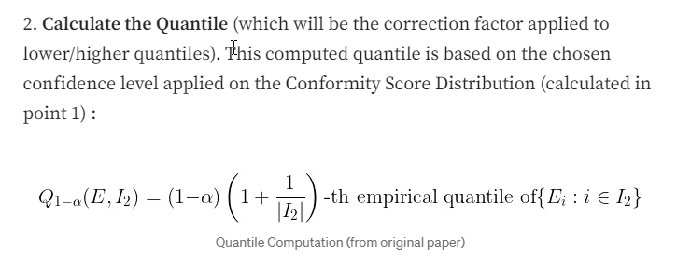
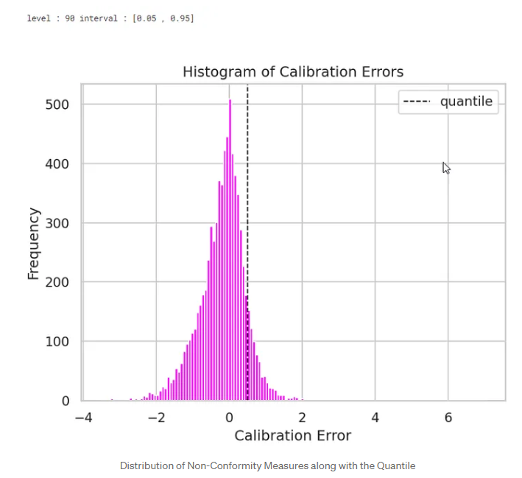
Quantiles Computation
1) We define a confidence level
2) We position this level on the sorted error distribution (Non-Conformity Score distribution)
3) We look at the error at this location by computing the Quantile
4) We will use this error later (next slide) as a corrector to apply to our Quantile Points Predictions
α : miscoverage rate or the significance level (proportion of instances where the true value is expected to fall outside the predicted interval)
1 - α : confidence level (proportion of instances where the true value is expected to fall inside the predicted interval)
E : Non-Conformity Score ordered Distribution
I₂ : Calibration Set Size (Normalization Factor)
This calculation of the quantile here has nothing to do with quantiles predicted by the model!

Slide 34

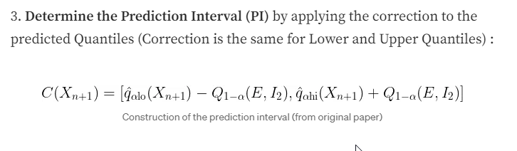
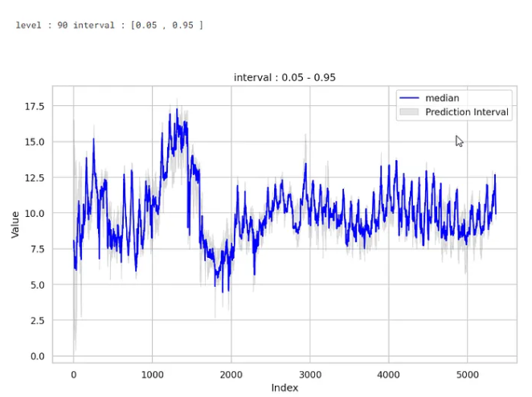
Prediction Intervals Computation

Slide 35
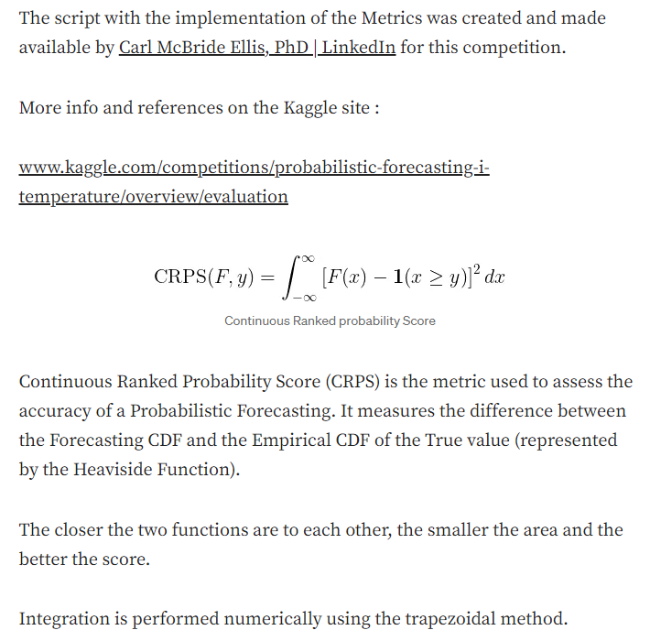
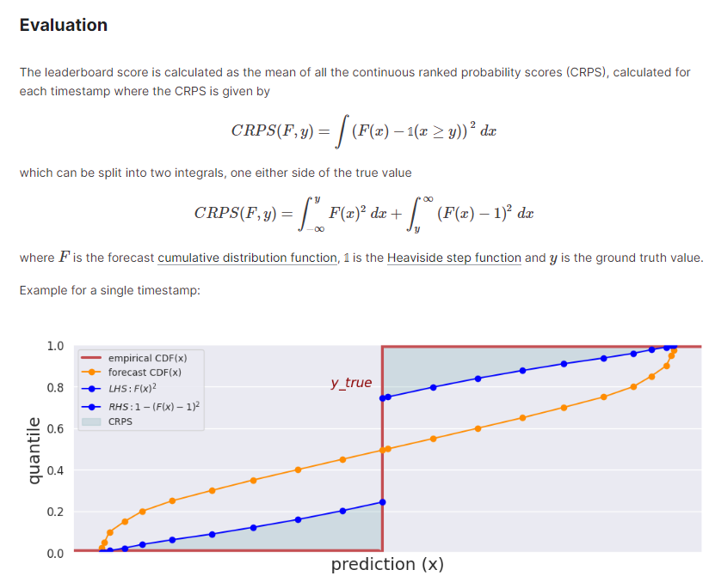
Evaluation Metrics
Area between the predicted CDF and the Heaviside function across all possible values of x indicates how well the predicted distribution matches the actual observation.

Slide 36
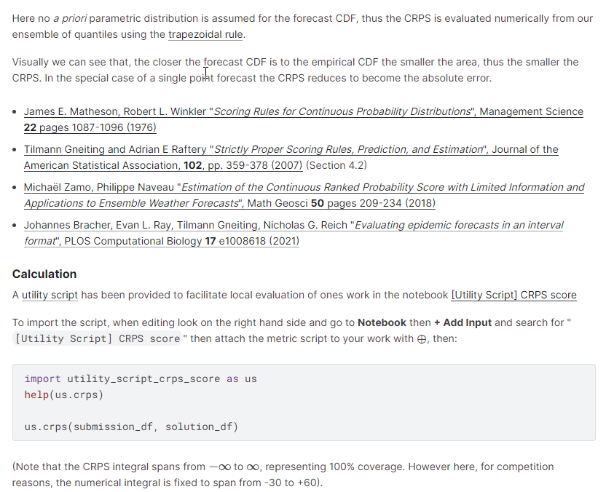
Evaluation Metrics

Slide 37
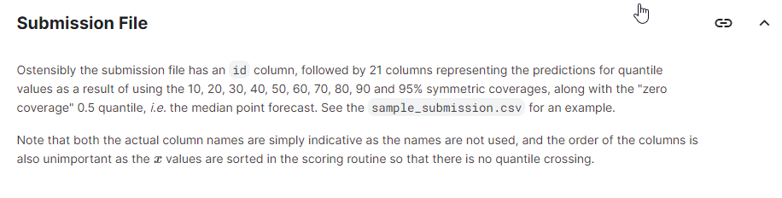
Submission file

Slide 38

Thank you for your Attention! Click on me !
The Secret of victory is now revealed

